Slide 1

Performance Analysis and Optimization of 9-Point Stencil Computation Using POSIX Threads, OpenMP, MPI, and Hybrid MPI+OpenMP
By: Michael Dandrea, Devin Guo and Ryan McCormick

Slide 2
Project Background
Stencil computations are a fundamental algorithm class in scientific computing, used for applications like image processing and numerical simulations.
The study focuses on a 9-point stencil, which computes values based on neighboring elements in a 2D grid. We compare parallelization strategies to optimize performance.
Notes:
Stencil computations are a cornerstone of scientific computing, utilized in applications ranging from image processing to numerical simulations. Our focus is the 9-point stencil, which calculates new values in a 2D grid based on the surrounding neighbors. In this project, we compared parallelization strategies to identify optimal methods for performance improvement.

Slide 3
Methods Overview
The project implemented and analyzed the 9-point stencil using:
Serial Baseline Implementation
POSIX Threads (Pthreads)
OpenMP (Shared Memory)
MPI (Distributed Memory)
Hybrid MPI+OpenMP
Each method offers unique trade-offs in performance, complexity, and scalability.
Notes:
We implemented the 9-point stencil using five approaches: a serial baseline implementation, POSIX Threads, OpenMP, MPI, and a hybrid MPI+OpenMP. Each method introduces unique trade-offs regarding performance, scalability, and complexity, which we analyzed in detail.

Slide 4
Experimental Setup
Experiments were conducted on the Expanse supercomputer with:
Hardware: AMD EPYC 7742, 256 GB DDR4, HDR-100 InfiniBand
Matrix Sizes: 5000x5000 to 40000x40000 elements
Performance Metrics: Execution time, speedup, efficiency, and overhead
Data was collected using high-precision timing methods and analyzed for different configurations.
Notes:
Our experiments were conducted on the Expanse supercomputer, equipped with AMD EPYC 7742 processors, 256 GB of DDR4 memory, and HDR-100 InfiniBand. We tested matrix sizes ranging from 5,000 by 5,000 to 40,000 by 40,000, measuring execution time, speedup, efficiency, and communication overhead.

Slide 5
Performance Metrics
Key metrics analyzed in the study include:
Speedup: Ratio of serial to parallel execution time.
Efficiency: Speedup normalized by the number of threads/processes.
Overhead: Time spent in communication, synchronization, or management.
Resource Utilization: CPU, memory bandwidth, and network efficiency.
Notes:
We analyzed several key metrics: speedup, which is the ratio of serial to parallel execution time; efficiency, which normalizes speedup by the number of threads or processes; overhead from communication and synchronization; and overall resource utilization, including CPU, memory bandwidth, and network efficiency.

Slide 6
Implementation Details
Each approach followed a common stencil computation algorithm, with differences in parallelization strategy:
POSIX Threads: Manual thread management and synchronization.
OpenMP: Simplified directives for shared memory parallelism.
MPI: Distributed memory with halo exchanges.
Hybrid MPI+OpenMP: Combines inter-node and intra-node parallelism.
Notes:
Each approach followed a standard stencil computation algorithm. The main differences lay in how parallelization was applied. POSIX Threads managed threads explicitly, OpenMP used shared memory directives, MPI distributed workloads across nodes, and the hybrid method combined MPI for inter-node and OpenMP for intra-node parallelism.

Slide 7
POSIX Threads Implementation
This implementation uses POSIX threads to divide the workload across multiple threads, with explicit synchronization and memory management.
void* stencil_thread_func(void* args) {
ThreadArgs* threadArgs = (ThreadArgs*)args;
for (int iter = 0; iter < threadArgs->numIterations; iter++) {
for (int i = actualStart; i <= actualEnd; i++) {
for (int j = 1; j < cols-1; j++) {
matrix1[i][j] = (matrix[i - 1][j - 1] + ... + matrix[i][j]) / 9.0;
}
}
my_barrier_wait(threadArgs->barrier);
double **temp = matrix1; matrix1 = matrix; matrix = temp;
my_barrier_wait(threadArgs->barrier);
}
}
Notes:
The POSIX Threads implementation divided the workload among threads, requiring explicit synchronization and manual memory management. Here's a code snippet illustrating the thread function for the stencil computation. This is the core computational kernel of our stencil implementation. Each thread processes its assigned rows, computing new values based on a 9-point stencil average of neighboring cells. The double barrier synchronization ensures all threads complete their computations before swapping matrices for the next iteration.

Slide 8
OpenMP Implementation
The OpenMP implementation simplifies thread management with compiler directives, ensuring efficient parallelization with minimal code complexity.
#pragma omp parallel for
for (int i = 1; i < rows - 1; i++) {
for (int j = 1; j < cols - 1; j++) {
matrix1[i][j] = (matrix[i - 1][j - 1] + ... + matrix[i][j]) / 9.0;
}
}
double **temp = matrix1; matrix1 = matrix; matrix = temp;
Notes:
OpenMP simplified parallelization using compiler directives. This is the OpenMP version of our stencil computation. The key difference is the use of '#pragma omp parallel for', which automatically distributes the work across threads. Instead of explicit barrier synchronization, OpenMP handles the thread coordination implicitly after each parallel region.

Slide 9
MPI Implementation
MPI distributes the matrix rows across processes, with halo exchanges for boundary communication, optimizing performance on distributed memory systems.
void stencil2DMPI(double **subs, double **subs1, MPI_Datatype dtype, int m, int n, MPI_Comm comm) {
for (int i = 1; i < local_rows - 1; i++) {
for (int j = 1; j < n - 1; j++) {
subs1[i][j] = (subs[i - 1][j - 1] + ... + subs[i][j]) / 9.0;
}
}
}
void exchange_row_striped_values(void ***subs, MPI_Datatype dtype, int m, int n, MPI_Comm comm)
Notes:
In the MPI implementation, matrix rows were distributed across processes. In this version of our stencil computation, each process works on its local portion of the matrix, defined by 'local_rows'. The custom MPI datatype handles the communication of ghost regions between processes, though not shown in this core computational loop.

Slide 10
Hybrid MPI+OpenMP Implementation
This implementation combines inter-node MPI communication with intra-node OpenMP parallelization, achieving optimal scalability for large problem sizes.
#pragma omp parallel for
for (int i = 1; i < local_rows - 1; i++) {
for (int j = 1; j < n - 1; j++) {
subs1[i][j] = (subs[i - 1][j - 1] + ... + subs[i][j]) / 9.0;
}
}
MPI_Barrier(comm);
Notes:
The hybrid MPI+OpenMP approach combined inter-node MPI communication with intra-node OpenMP parallelism, providing scalable solutions for large matrix sizes. This is our hybrid MPI+OpenMP implementation, combining distributed and shared memory parallelism. Each MPI process spawns multiple OpenMP threads to compute its local portion of the matrix. The MPI barrier ensures all processes complete their computations before exchanging boundary data.

Slide 11


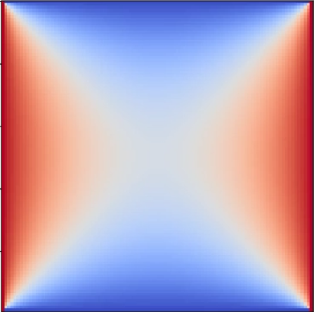
Heat Transfer Plates
Initial State Middle State Final State
Notes:
Here’s an example of the 9-point stencil applied to a heat transfer simulation. The images depict various stages of the evolution of the heat transfer across a plate, from the initial to the final state, after 5,000 iterations on a 100x100 matrix.

Slide 12
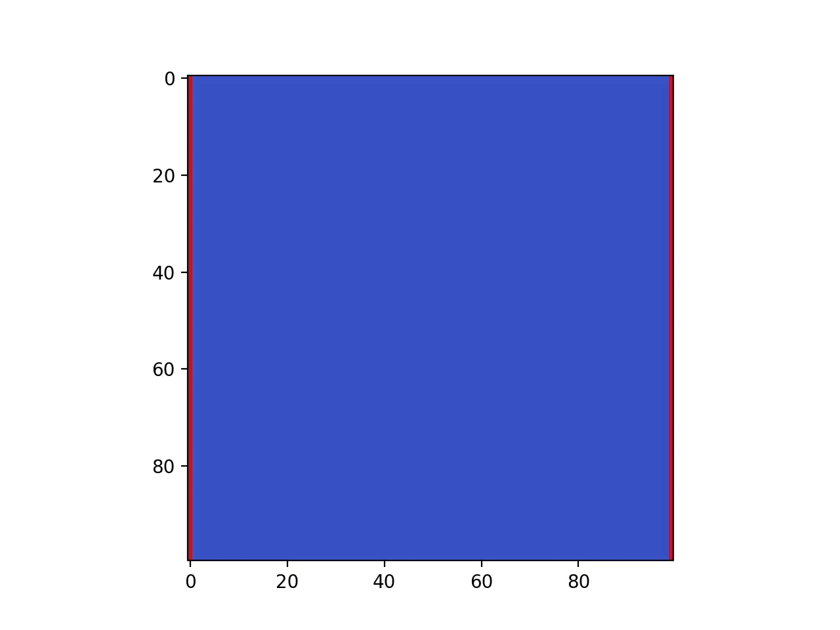
Heat Transfer Movie
100 x 100 Matrix
5000 Iterations

Slide 13
MPI, OpenMP, and Pthread Analysis

Slide 14
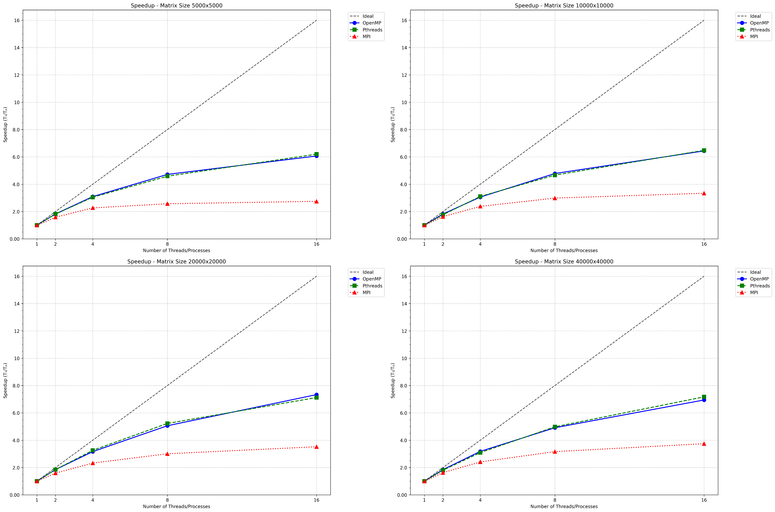
Notes:
These graphs illustrate the speedup performance of OpenMP, Pthreads, and MPI for matrix sizes ranging from 5,000x5,000 to 40,000x40,000, with the dashed line representing ideal linear scaling. OpenMP and Pthreads demonstrate efficient shared memory utilization, closely approaching ideal scaling for smaller thread counts, though performance slightly declines at higher thread counts due to synchronization overhead. MPI, while effective for larger matrix sizes, experiences slower scaling and higher overhead because of communication costs. Larger matrices improve scaling across all methods, with OpenMP and Pthreads outperforming MPI in single-node setups, while MPI proves more suitable for distributed systems when communication is carefully managed. In summary, OpenMP and Pthreads excel in shared memory environments, while MPI requires optimization to mitigate its communication overhead in distributed settings.

Slide 15
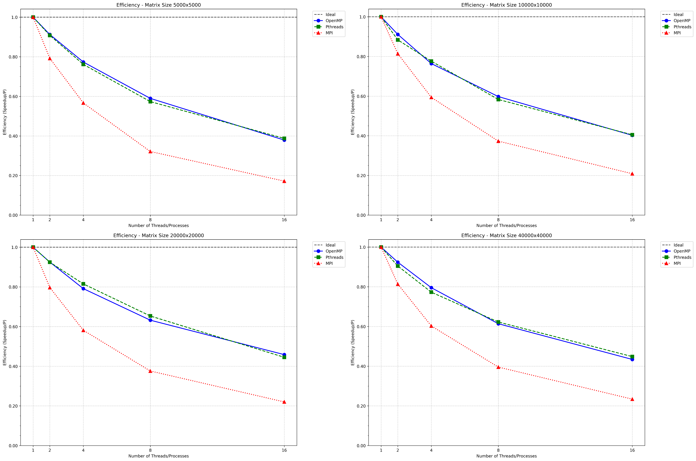
Notes:
These graphs illustrate the efficiency of OpenMP, Pthreads, and MPI for different matrix sizes, with ideal efficiency shown by the dashed line. Efficiency decreases as the number of threads or processes increases due to synchronization, communication, and resource contention. OpenMP and Pthreads maintain higher efficiency than MPI, especially for smaller thread counts and larger matrix sizes, as they avoid the communication overhead inherent to distributed systems. MPI shows a more pronounced drop in efficiency for smaller matrices but improves with larger workloads as the computation-to-communication ratio increases. Overall, OpenMP and Pthreads are more efficient for shared memory systems, while MPI benefits from larger matrix sizes in distributed environments.

Slide 16
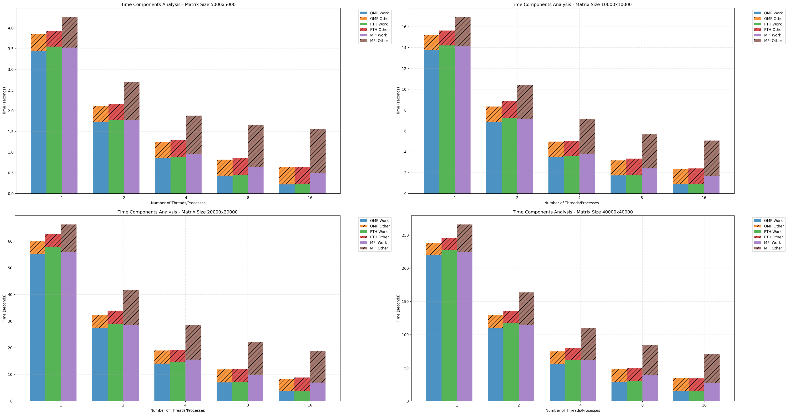
Notes:
These bar charts show the time components for OpenMP, Pthreads, and MPI across matrix sizes, broken down into computational work and other overheads. As the number of threads or processes increases, the computational time decreases, indicating effective parallelization. However, the overhead components (e.g., synchronization for OpenMP and Pthreads or communication for MPI) become more significant, particularly for MPI, where communication dominates at higher process counts and smaller matrix sizes. Larger matrices reduce the relative impact of overheads, especially for MPI, by increasing the computation-to-communication ratio. Overall, these graphs highlight the trade-off between computation and overhead across different parallelization methods and problem sizes.

Slide 17
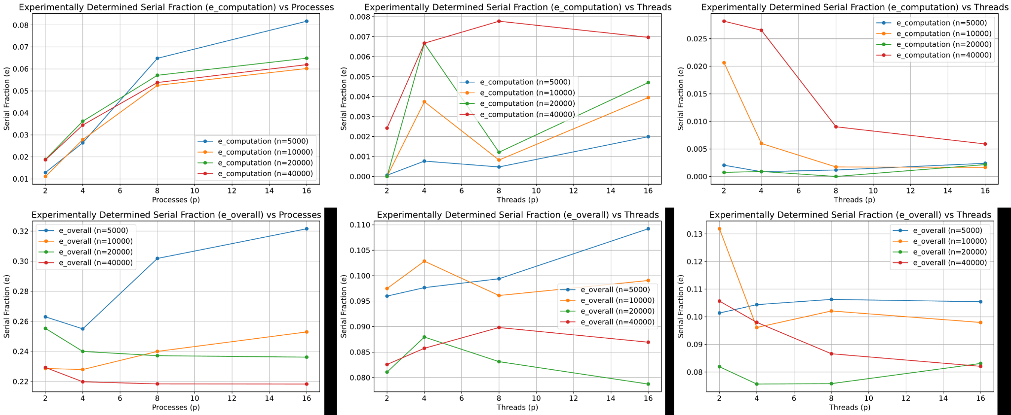
Notes:
These graphs illustrate the experimentally determined serial fraction for both computation and overall execution. The serial fraction, which represents the portion of the workload that cannot be parallelized, generally increases with the number of processes, especially for smaller matrices, due to communication and synchronization overhead. For larger matrices, the serial fraction is lower, reflecting better parallel efficiency as the computational workload dominates. In the thread-based graphs, the trends vary more due to shared memory effects, with smaller matrices showing higher variability. Overall, the results emphasize the importance of balancing computational workload and overhead to minimize the serial fraction and achieve better scalability.

Slide 18
MPI + OpenMP Hybrid Analysis

Slide 19
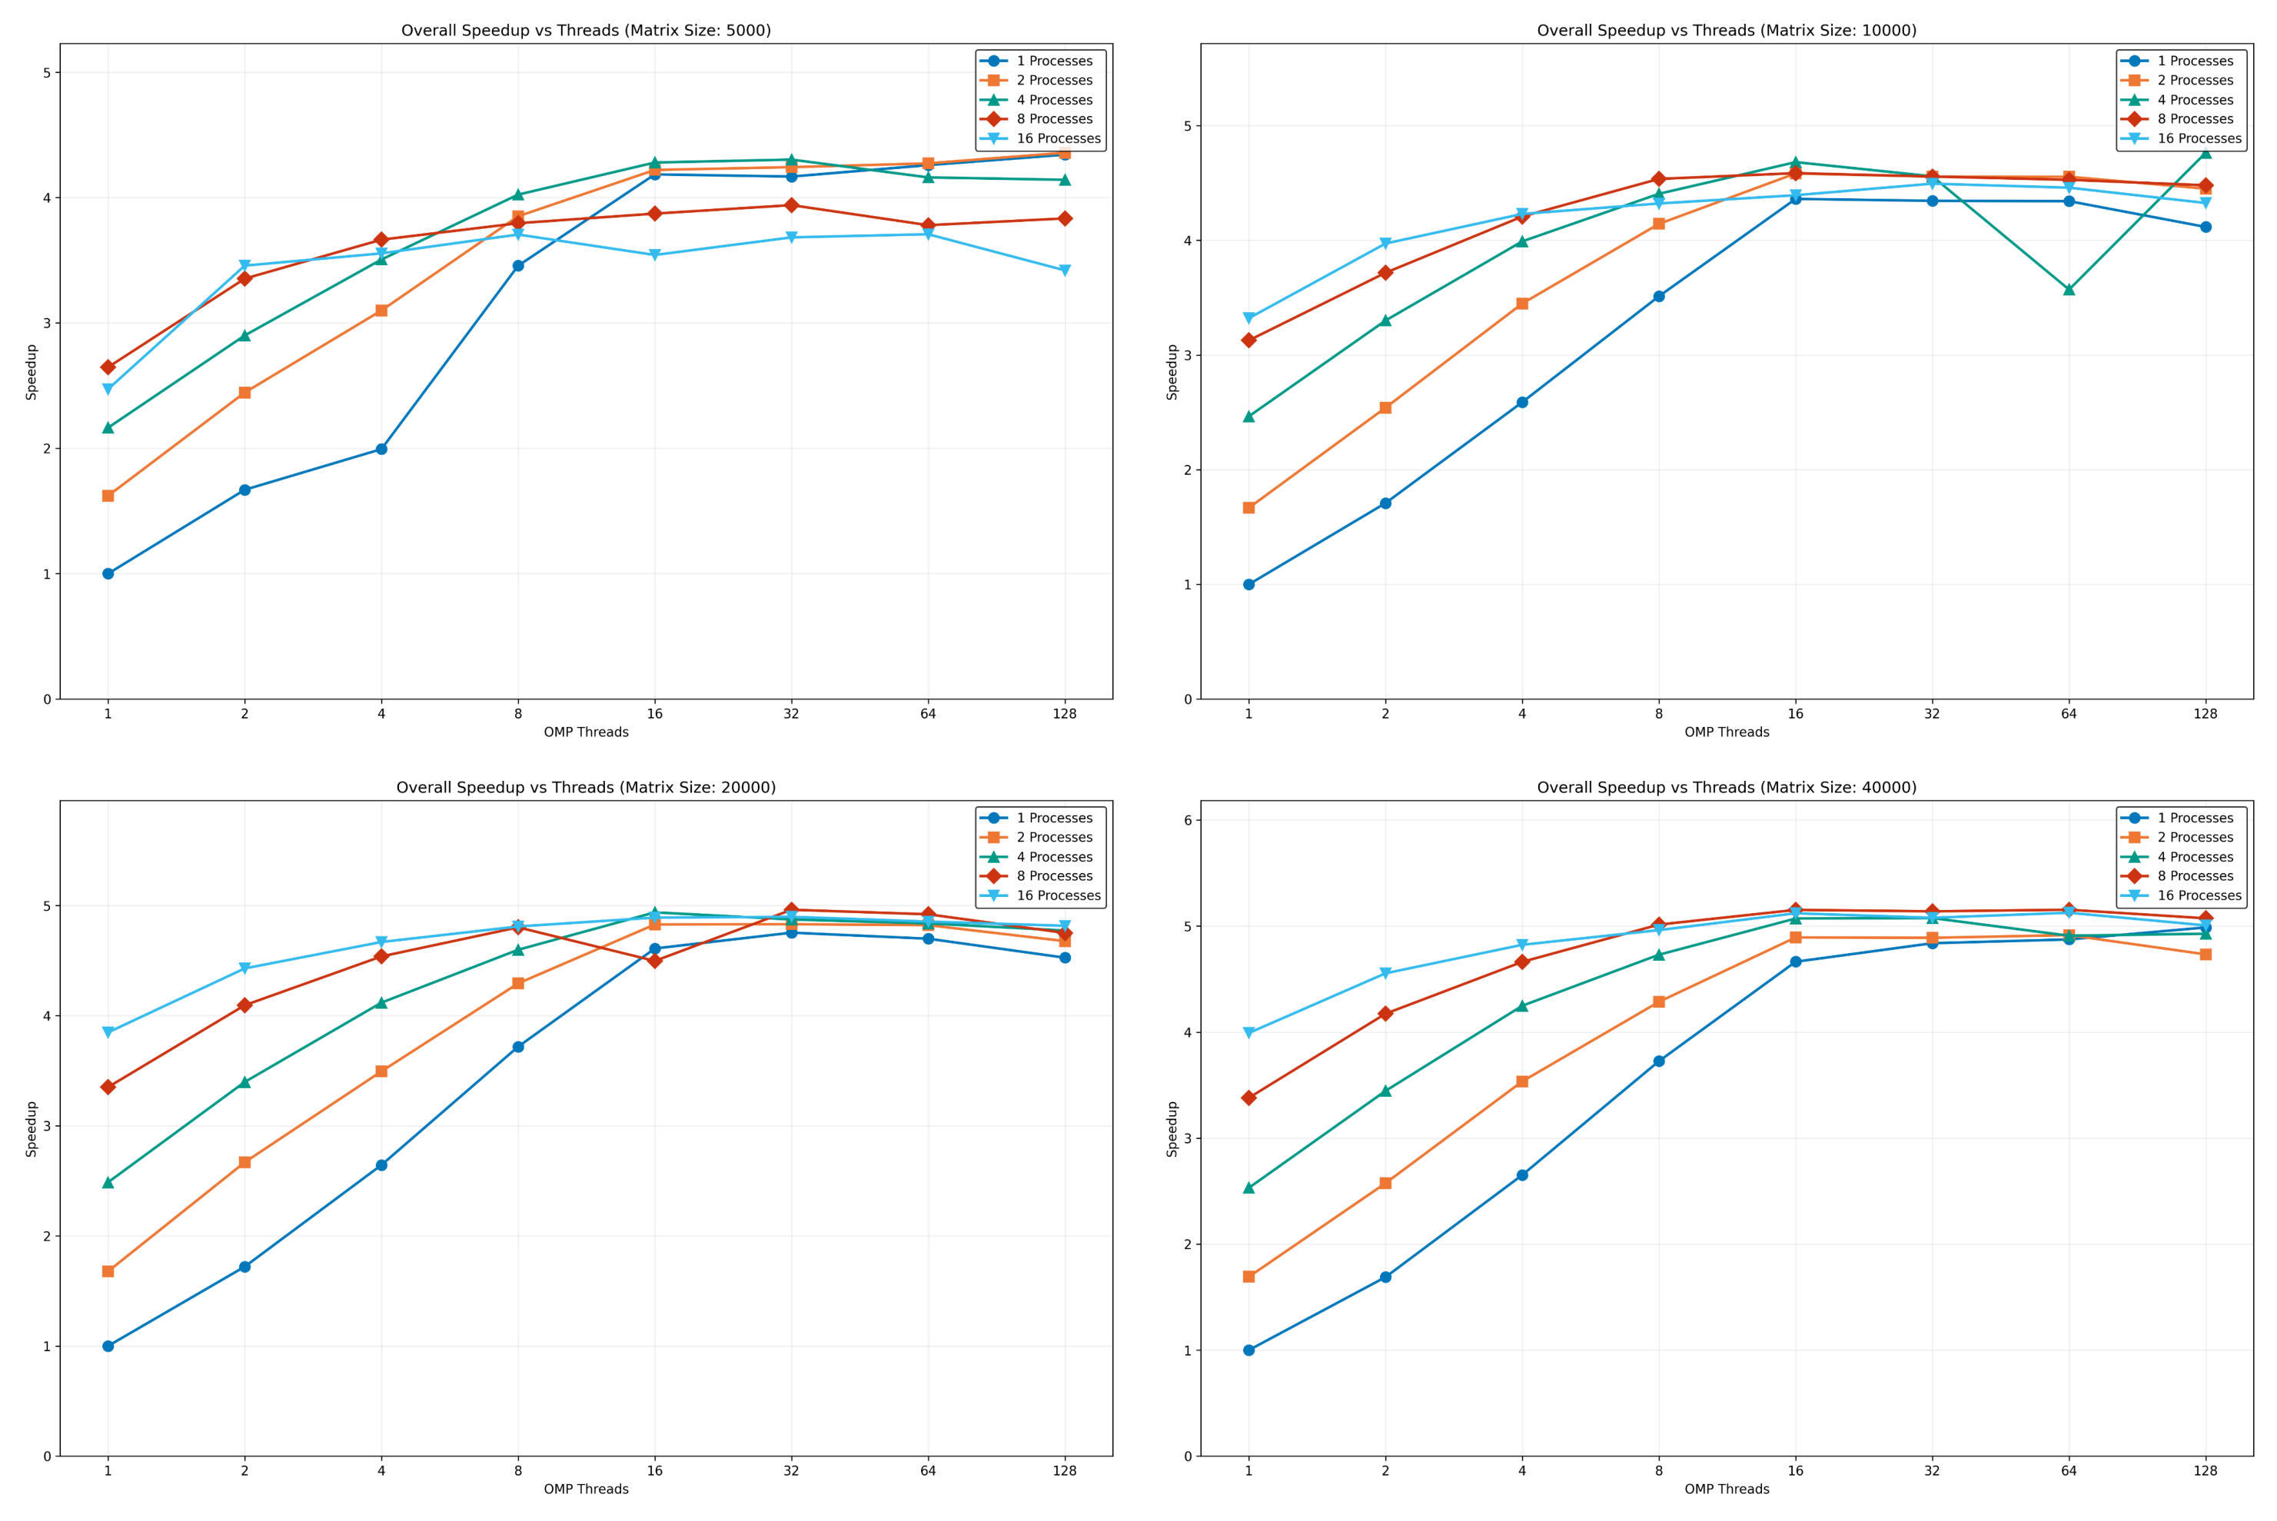
Notes:
These graphs show our parallel performance testing across different matrix sizes from 5000 to 40000. The key findings are:
Single-process runs (in blue) start slow but catch up when using many threads. The 16-process configuration (cyan) performs well initially but plateaus early. Most configurations hit peak performance around 16-32 threads, with larger matrices showing better overall speedup - up to 5x improvement.

Slide 20
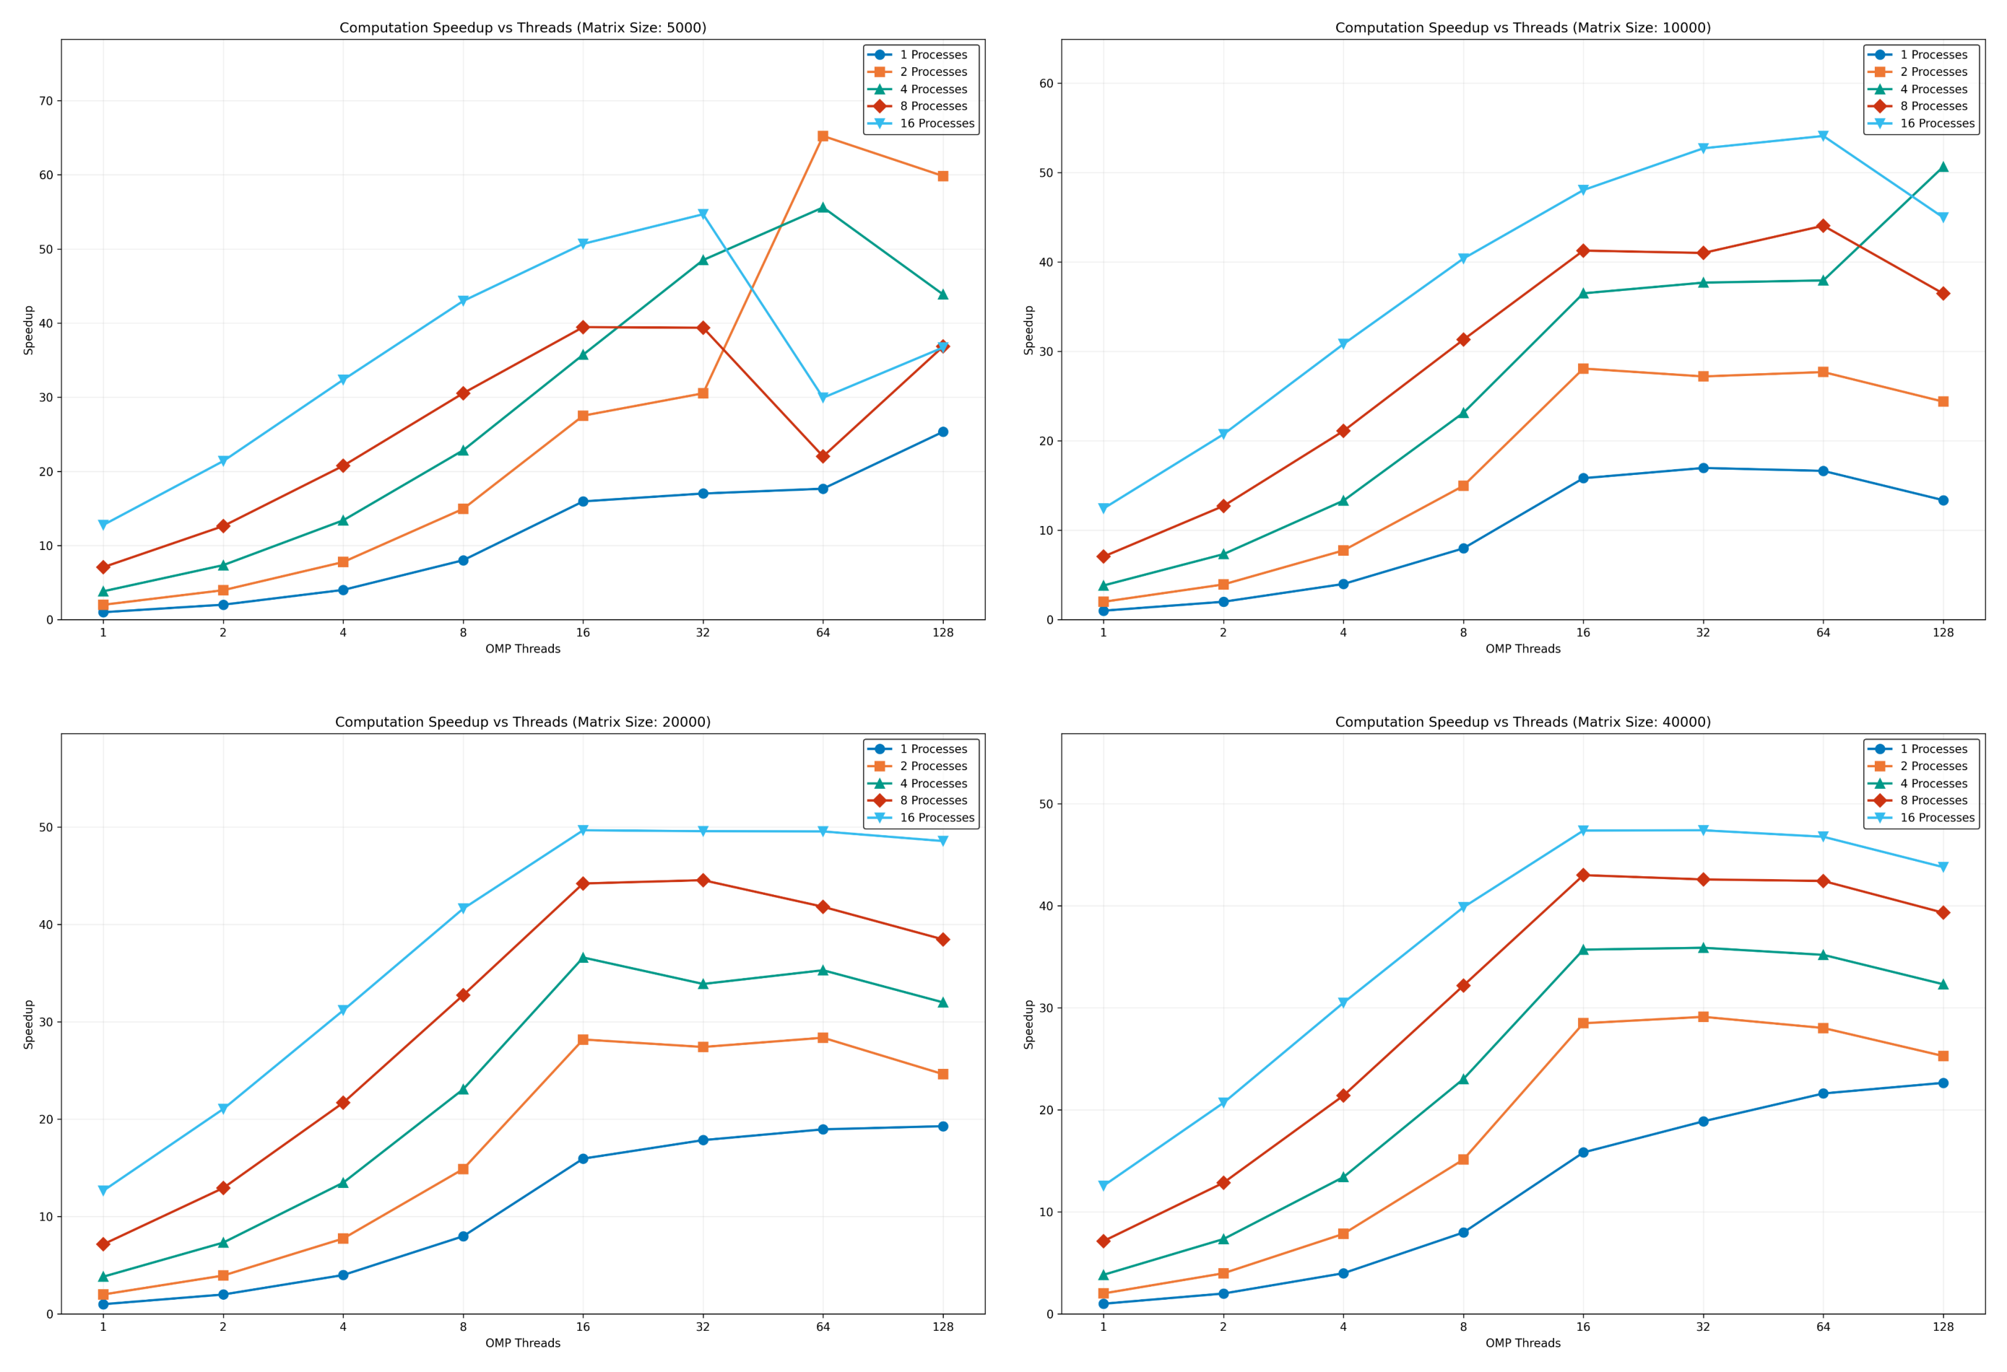
Notes:
These graphs show computation-specific speedup across different matrix sizes. The most striking feature is the significantly higher speedup factors - reaching up to 65x for smaller matrices and stabilizing around 50x for larger ones. The 16-process configuration consistently shows the best performance, particularly with mid-range thread counts. However, we see more performance volatility in smaller matrices, especially at high thread counts, while larger matrices show more stable scaling behavior.

Slide 21
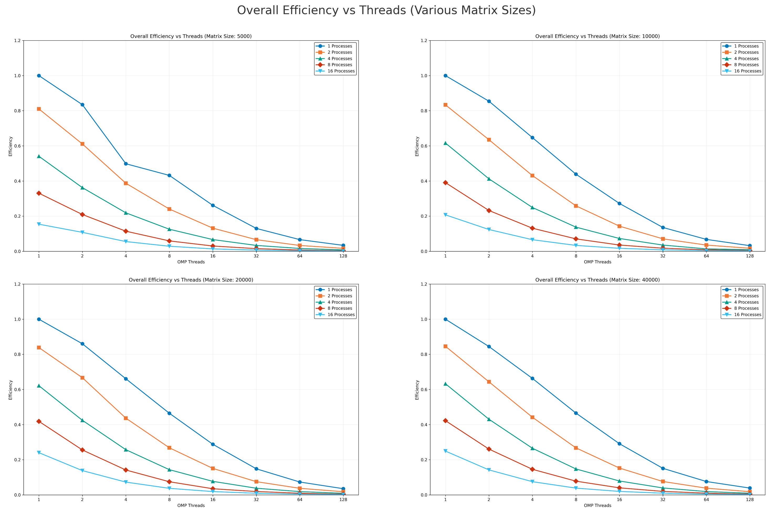
Notes:
These efficiency graphs reveal an important trade-off in our parallel implementation. Single-process runs start with near-perfect efficiency but decline as we add threads. Configurations with more processes start at lower efficiency and decrease more rapidly. The pattern is consistent across all matrix sizes, with efficiency dropping below 0.2 for most configurations beyond 16 threads. This suggests that while we achieve good speedup, we pay a cost in terms of resource utilization, particularly at higher thread counts.

Slide 22
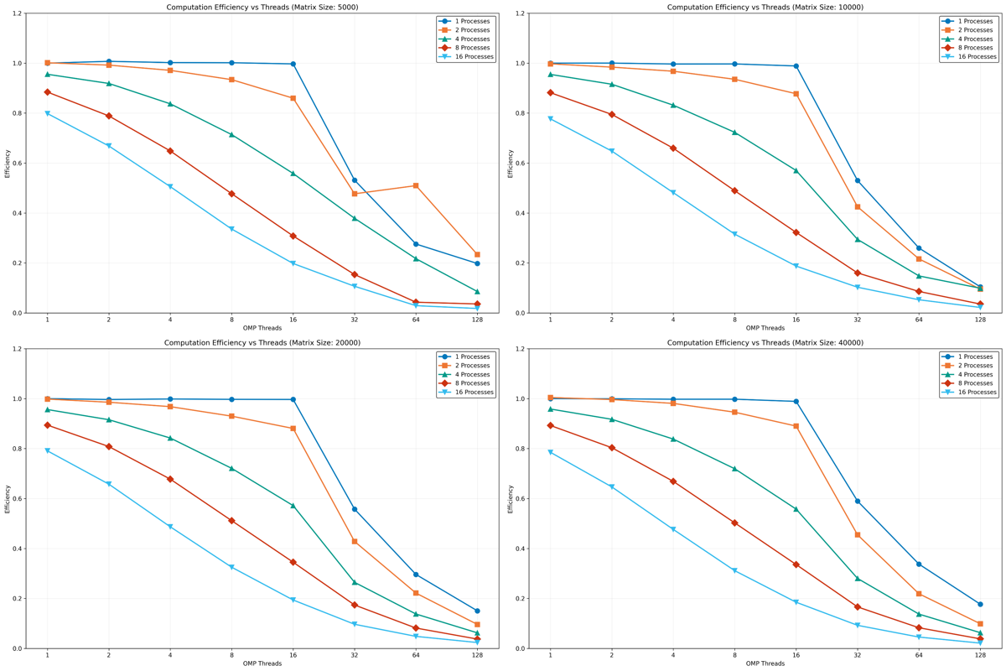
Notes:
Looking at computation-specific efficiency, we see a more optimistic picture compared to overall efficiency. Single and dual-process configurations maintain near-perfect efficiency up to 16 threads, showing excellent resource utilization for the core computation. The efficiency decline is more gradual and consistent across matrix sizes, though still pronounced at high thread counts. This suggests our computation itself scales well, and the overall efficiency losses we saw earlier are largely due to other factors like communication overhead.

Slide 23
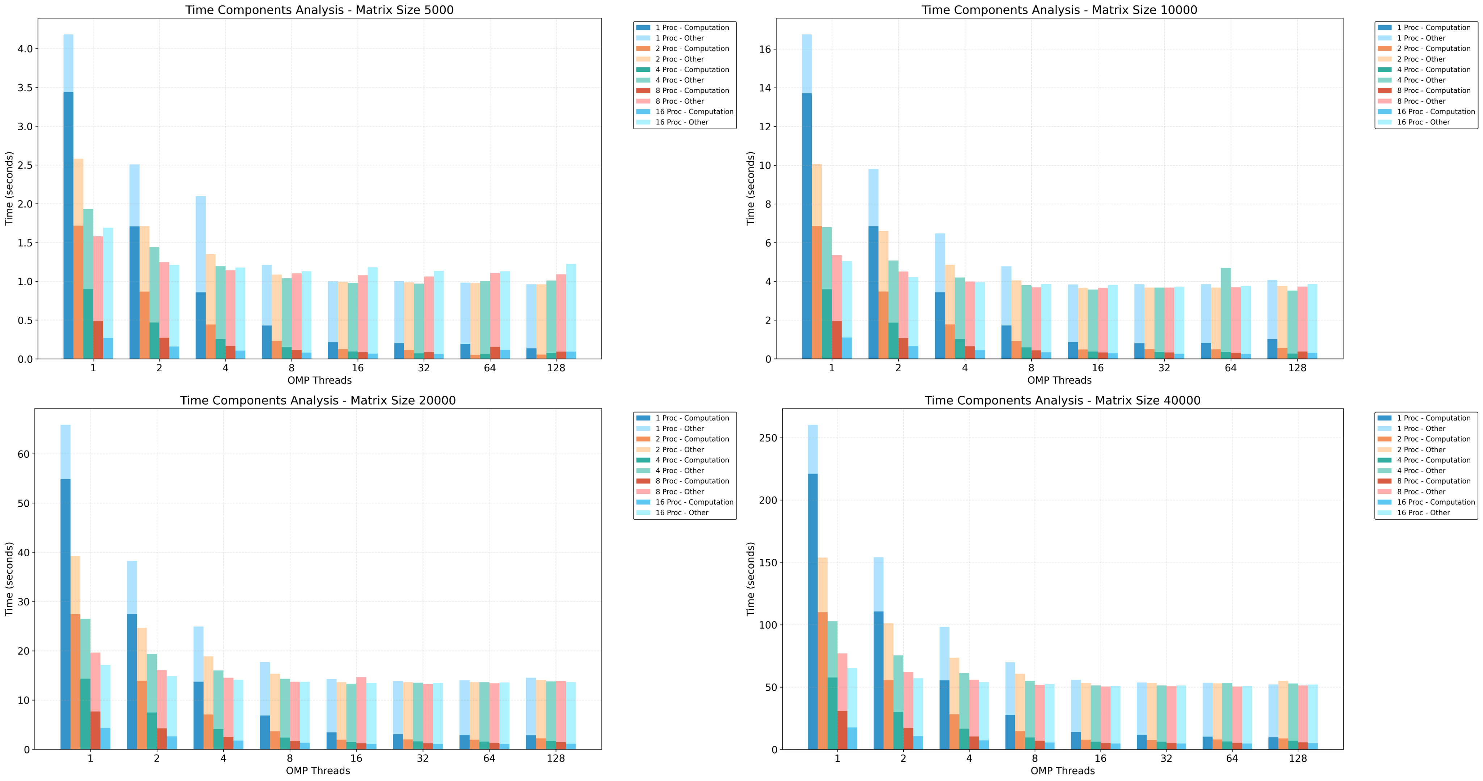
Notes:
These graphs break down execution time into computation versus other overhead across different matrix sizes. For large matrices of 40000, we see computation time dominating at low thread counts, taking up to 250 seconds with a single process. A key observation is that as we increase threads and processes, computation time drops significantly, but overhead remains relatively constant. This explains our earlier efficiency results - while we successfully reduce computation time, we hit a floor due to persistent overhead costs, particularly noticeable in configurations with high process and thread counts.

Slide 24
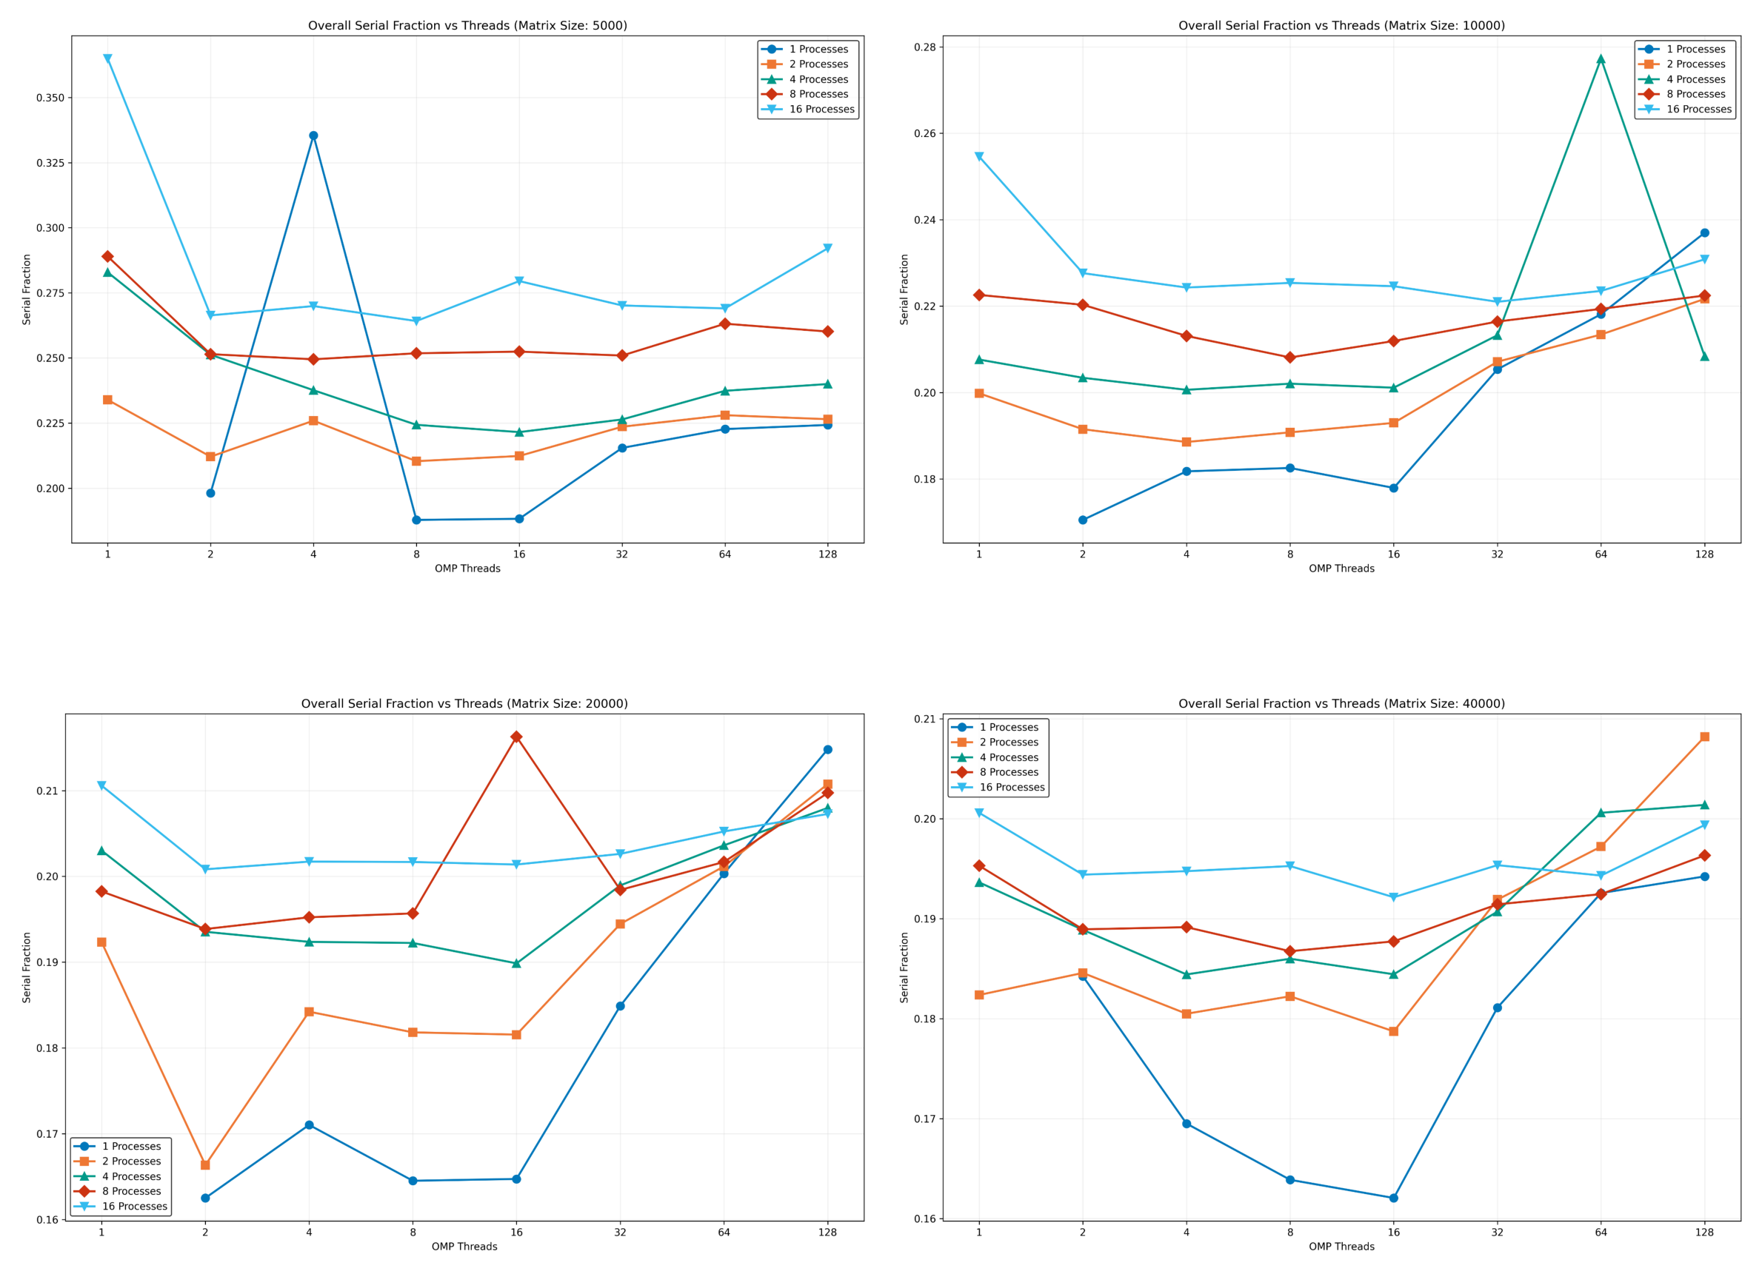
Notes:
These graphs show the proportion of our program that remains sequential despite parallelization. The serial fraction generally stays between 0.16 and 0.28 across all configurations, with some interesting patterns. For larger matrices, we see more stable behavior with serial fractions around 0.18-0.21. The fluctuations at high thread counts, particularly visible in smaller matrices, suggest diminishing returns from parallelization and align with our earlier efficiency observations. This inherent sequential portion explains why we couldn't achieve perfect speedup in our earlier results.

Slide 25
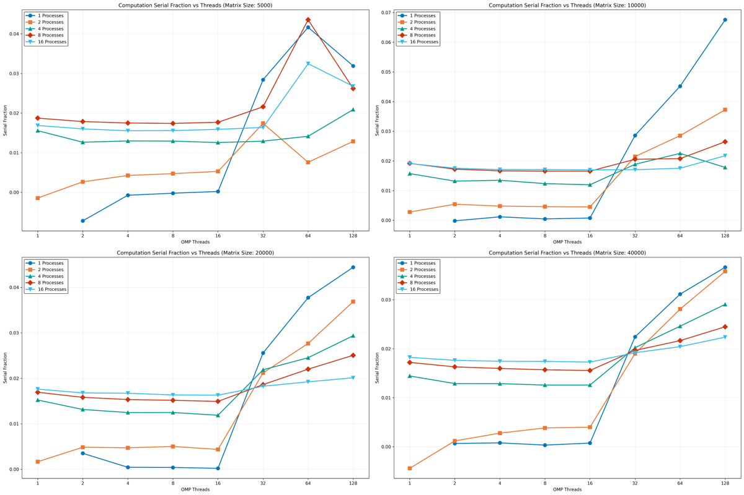
Notes:
--- LAST SLIDE ---
Looking at the computation-specific serial fraction, we see much lower values - generally below 0.04 across all matrix sizes - compared to the overall serial fraction we saw earlier. This confirms that our core computation is highly parallelizable. However, there's a notable trend across all matrix sizes: the serial fraction remains stable until around 16-32 threads, then increases sharply, especially for configurations with fewer processes. This suggests a fundamental limit to our parallelization strategy at high thread counts, even for the computation itself.

Slide 26
Results and Analysis
Performance comparisons revealed distinct patterns:
OpenMP and Pthreads showed similar scaling for single-node systems.
MPI achieved strong scaling across nodes but had communication overhead.
Hybrid MPI+OpenMP offered the best balance for large problem sizes
Notes:
Our results revealed that OpenMP and Pthread implementations performed similarly for single-node systems. MPI achieved strong scaling across multiple nodes but suffered from communication overhead. The hybrid MPI+OpenMP method provided the best balance of computational efficiency, and communication management for large matrices.

Slide 27
Conclusions
Key Findings:
Parallelization significantly improves performance for large matrices.
Hybrid MPI+OpenMP balances computational and communication overhead.
Resource management and optimization are critical for scalability.
Notes:
In conclusion, we observed that parallelization significantly improved performance for large stencil computations. The hybrid MPI+OpenMP method emerged as the most effective for scalability, balancing computational and communication overhead. This study highlights the importance of strategic resource management for optimizing performance in scientific computing.

